Slide 1
Select
Raise
Mate
Grow
Selecting the parent stock

Slide 2

Healthy colonies only
Any stock used to raise queens must be disease free.
Do a full disease inspection before any queen raising.
I do this as inspection 2 of the season.
This applies to all colonies contributing bees or kit to the process.

Slide 3
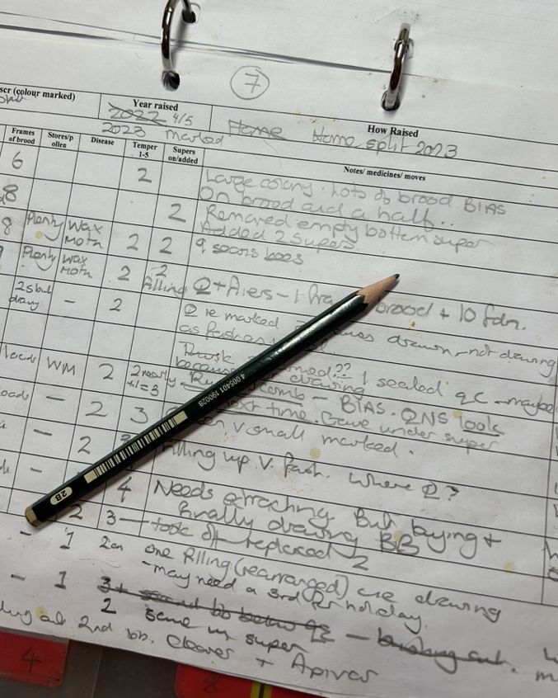
What characteristics are you selecting for?
Honey production
Temperament
Overwintering
Colony size
Disease (and varroa) resistance
Swarminess
Type of bee

Slide 4
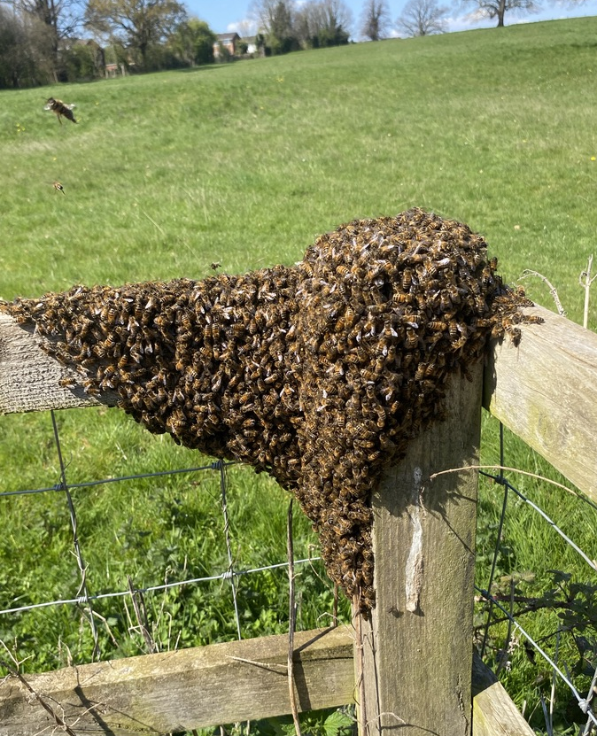
Is the parent colony swarmy?
Is it too large for it’s box?
Is the queen you are considering from an unknown swarm?
Is this queen from a colony that threw casts when you got this queen?
Has the queen you are considering swarmed in her first year?
Image: Barry Meatyard

Slide 5
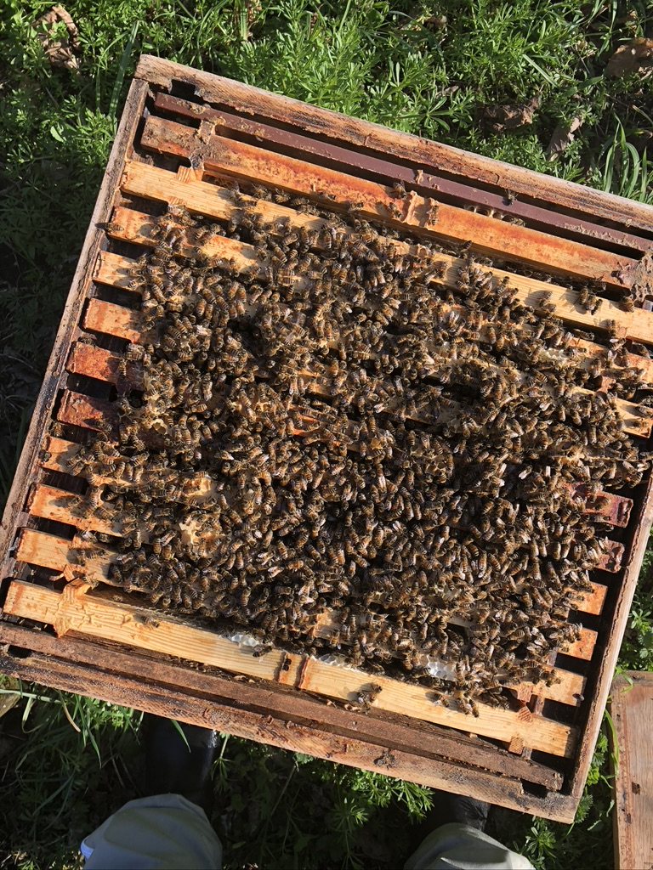
A selection process
Ideally, consider more than one year of records
Priorities are individual – for me, temperament, smarminess and disease resistance.
Do a visual analysis of your records - not an average score

Slide 6
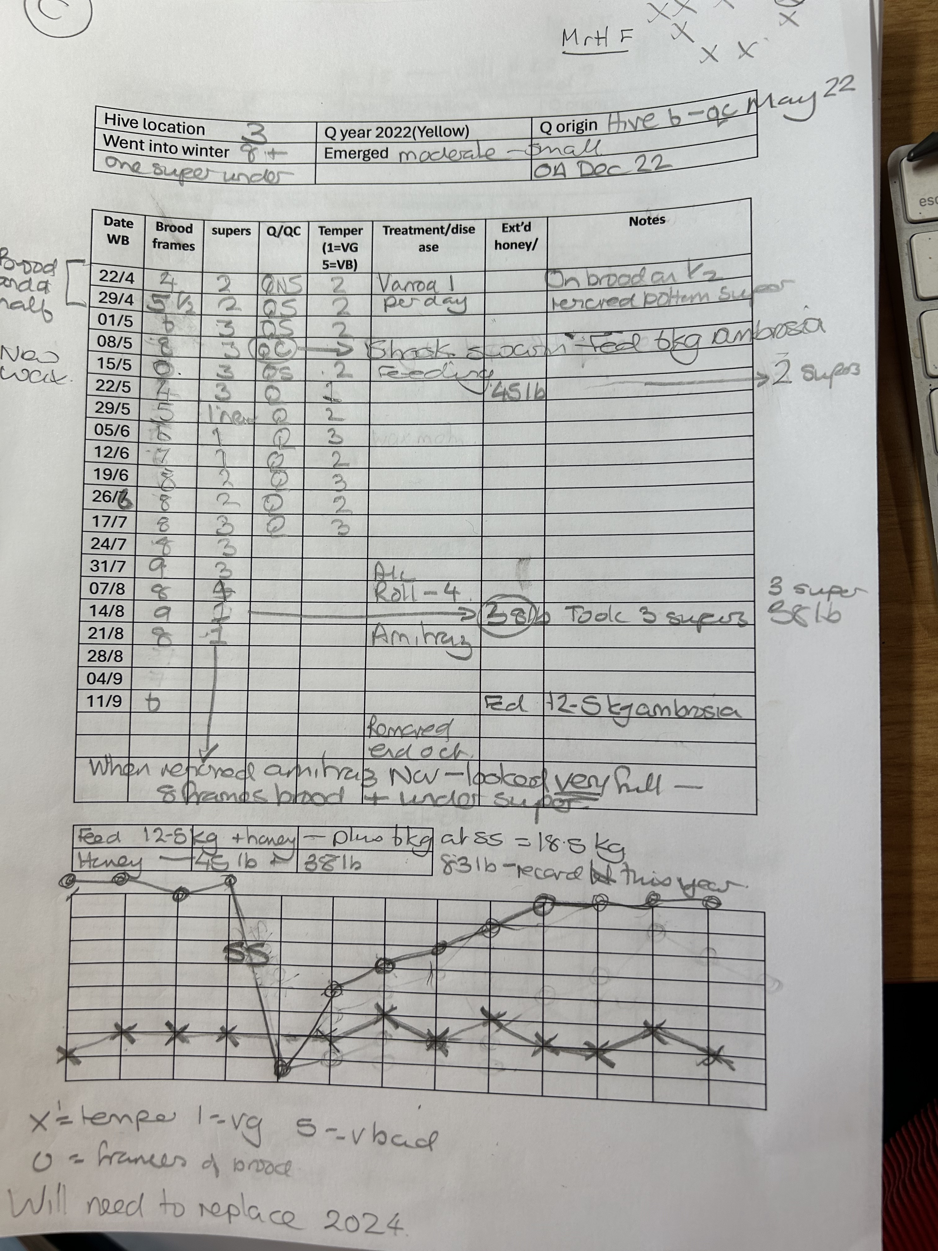
Task: In groups
Read one side of one of the record sheets (if you can).
All in the same apiary and didn’t move sites. All came out of winter with a super underneath the brood.
Describe the colony’s year as best you can to your group members.
Which colony would you choose to breed from?

Slide 7
Scenarios
A. Queen 8 (tan- marked yellow) 2nd year, product of May split (old brood), 2022- 35lb honey. 2023 started7 brood, Pagden end of May (in AS). Ended season with unmarked Q- supersedure? Temper moderate.
B. Queen 5 (tan/hairy) is entering her second year (marked Yellow) from Pagden early last year (didn’t swarm after). Last year went into winter large but came out small- took additional 3kg fondant.
Started year on brood and a half. Moderate growth all season. Good temper. 35lb honey approx. Took 12.5kg feed.
C. Queen 7 (dark tan) entering from June Pagden (AS) 2022. SS early May 2023 so fed also fed winter so quite high ambrosia consumption. June, July, 8-10 and half. Added half late June. Temperament 2-3, but only in good weather. Took 35lb May and 38 lb Aug- anomalously large. Robbing?.

Slide 8
Select
Raise
Mate
Grow
A simple way to raise queens from emergency cells

Slide 9
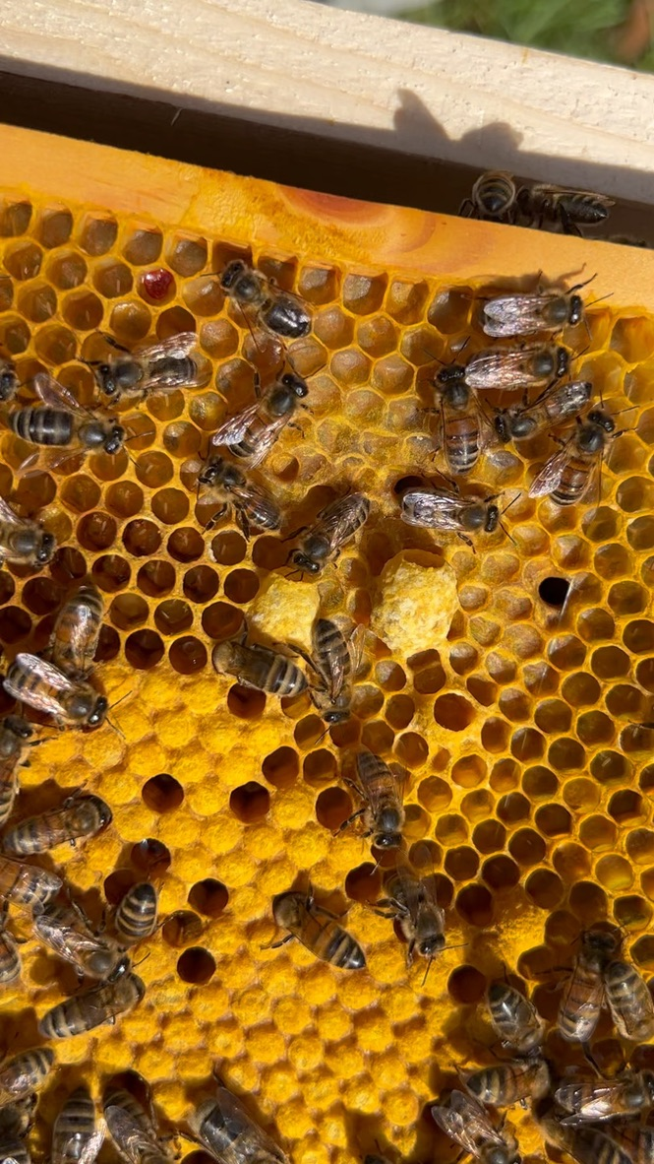
Using emergency cells to raise queens
When you don’t want to wait for the bees to make swarm cells.
Pre-emptive swarm control.
The bees have not chosen the very best eggs.
If started from older larvae emergency cells ARE inferior.
The key is to have plenty of young larvae and well-fed nurse bees.

Slide 10
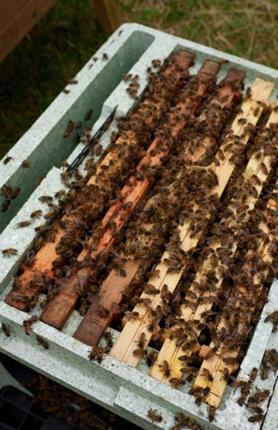
Pre-emptive splits – remove the queen
Use a selected, strong colony.
Take out the queen with at least:
  1 full or 2 frames sealed brood,
  1 frame eggs and young larvae
  1 frame stores
  Shake in 2 combs of nurse bees
Fill the rest of the nuc with foundation or drawn comb and feed

Slide 11
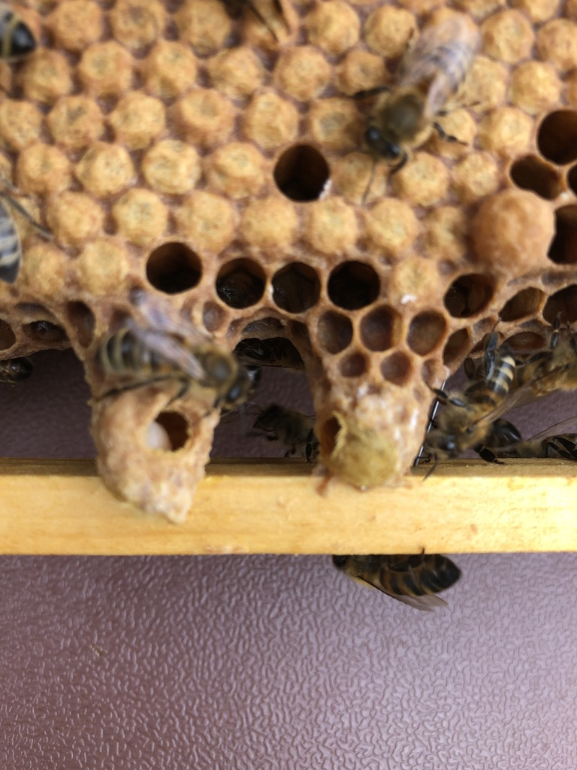
Use the rest of the colony for nucs
Split the remaining frames into nucs and feed.
Each nuc needs (as the very minimum)
  Frame of eggs and young larvae
  Frame of sealed brood
  Frame of stores
  Nurse bees
  Feeder with syrup
Feed and leave undisturbed for at least four weeks.
To cull or not to cull the emergency cells?

Slide 12
Open up your selected, strong colony
Q
Day 1

Slide 13
Take the queen and frames of open and sealed brood out as a nuc
Q
Day 1

Slide 14
Make up the rest of the nucs with foundation (or DC) and feed
Feed
Feed
Feed
Q
Day 1

Slide 15
On day 4-7 you COULD check for multiple queen cells- but don’t HAVE to
Feed
Feed
Feed
Q
Day 7

Slide 16
By day 28 you should have mated queens
Feed
Feed
Feed
Q
Q
Q
Day 28 (ish)

Slide 17
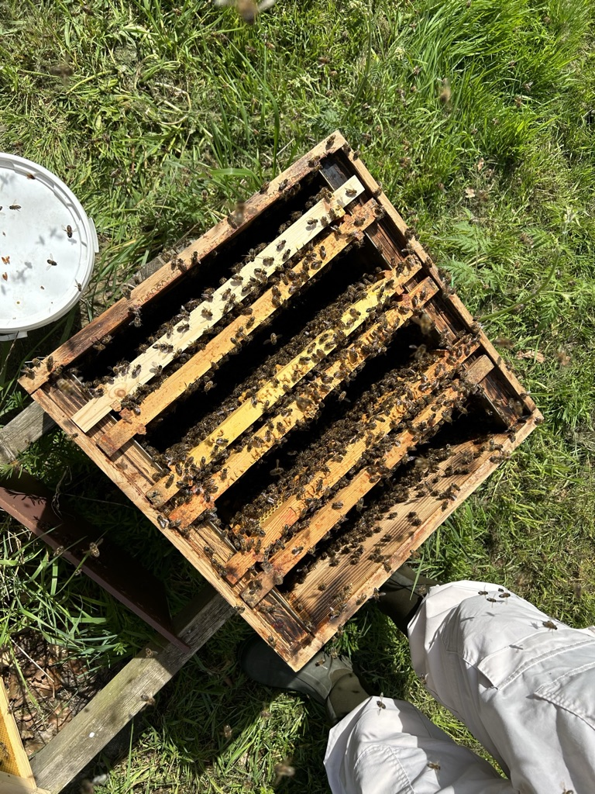
Biggest challenge?
Finding the queen in big colonies.
If you can’t, this method allows you to split anyway- she will be in one of the nucs!

Slide 18
Select
Raise
Mate
Grow
Mating

Slide 19
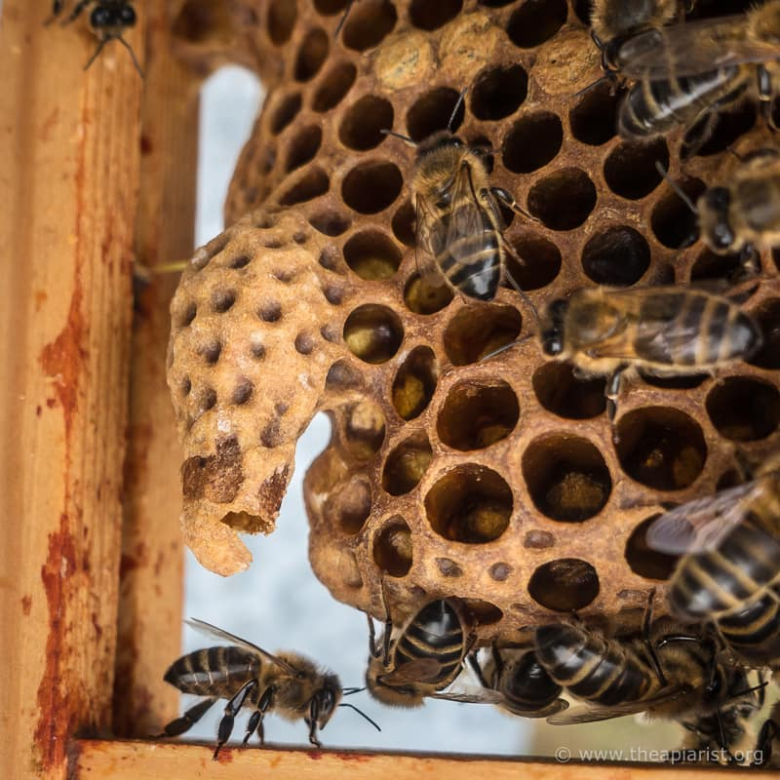
After hatching, the queen will take:
5 (or more) days to mature
3-8 days to mate and mature the sperm before laying
Don’t panic but if the queen does not mate in three or four weeks, it may be too late.

Slide 20

We know what we are aiming for.

Slide 21
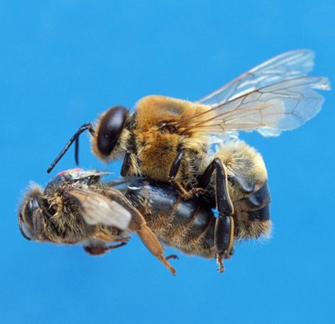
Most queens…
Will find a Drone Congregation area
90% of all matings occurred within 7.4 km and 50% within 2.4 km (Jensen, 2005)
Fly further than drones
Make several flights
Mate with 15-20 drones
Return safely

Slide 22
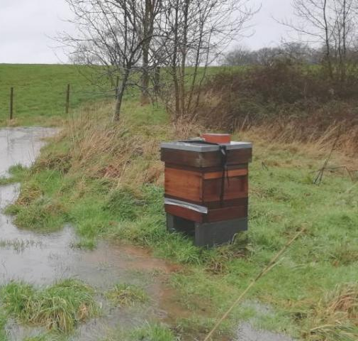
Not all mating will be successful
Position the nucs in different directions
You can’t control the weather- but after three weeks of so the queen may be “stale”.
The queen may not make it back

Slide 23
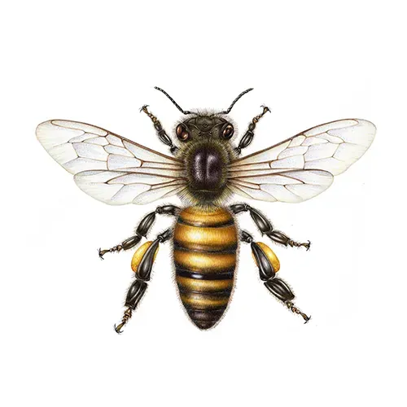
You can produce your own queens
Selecting the parent colony is the most important step
Jane argues that swarm cells are the best cells for queen raising
Emergency cells can produce good queens too
Bees raising queen cells must be young and well fed- they have to feed the future queens
Raise and mate your queens in what suits you - brood boxes, five, six or three frame nucs or apideas
Queens or cells can be introduced through introduction (tinfoil, cages) or uniting.
If you have two or three colonies, you can raise your own queens, have a replacement programme, overwinter a nuc or give one to a newcomer.

Slide 24
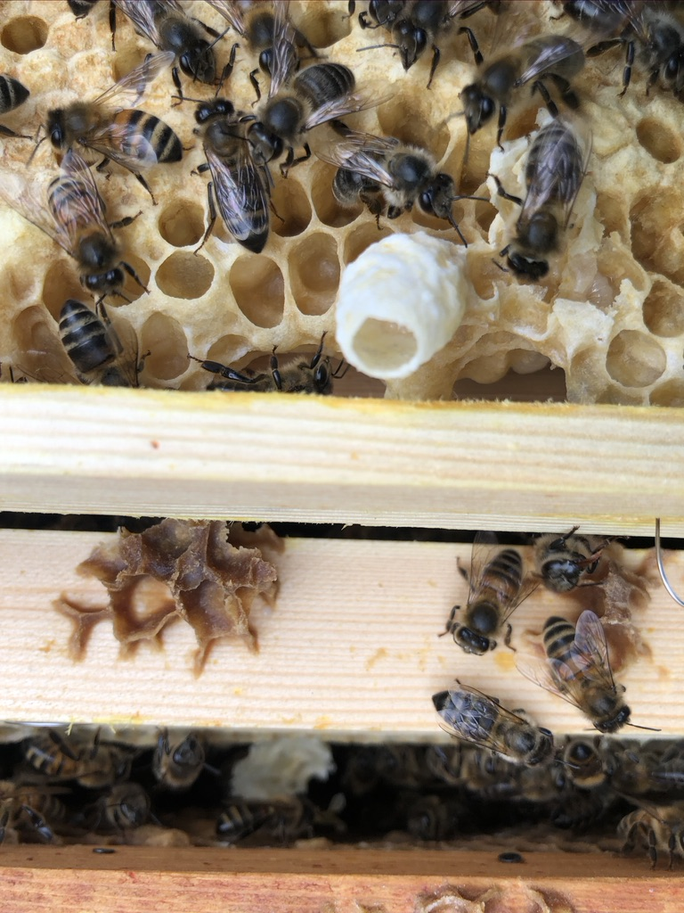
Recommended resources
The Apiarist.org - simply the best bee site out there.
NBU Miller Workbook (see Beebase)
Miller spreadsheet (See the unit on BBKA Learning Online)
If using Apideas, Dan Basterfield’s book on apideas- it is really good.

Slide 25
References
Costa, C., & Meixner, M. D. (2022). The COLOSS Research Network for Sustainable Bee Breeding. Bee World, 99(1), 23–25. https://doi.org/10.1080/0005772X.2021.1982569
Jensen, A., et al., (2005) Quantifying honey bee mating range and isolation in semi-isolated valleys by DNA migrostellite paternity analysis Conservation genetics 6:527-537
Soroker, V., Kovačić, M., & Hatjina, F. (2022). The COLOSS Varroa Task Force: Combating the Mite in the 21st Century. Bee World, 99(1), 14–16. https://doi.org/10.1080/0005772X.2021.1981678
Mao, W., Schuler M., and Berenbaum M., (2015). A dietary phytochemical alters caste-associated gene expression in honey bees. Science Advances 1(7).
Maori E., et al.(2019) 'A transmissible RNA pathway in honey bees.' Cell Reports; 2 May 2019; DOI: 10.1016/j.celrep.2019.04.073.

Slide 26
Maori E., et al. 'A secreted RNA binding protein forms RNA-stabilizing granules in the honeybee royal jelly.' Molecular Cell; 18 April 2019; DOI: 10.1016/j.molcel.2019.03.010.
He, X.J., Wei, H., Jiang, W.J., Liu, Y.B., Wu, X.B., and Zeng, Z. (2021) Honeybee (Apis mellifera) Maternal Effect Causes Alternation of DNA Methylation Regulating Queen Development. Sociobiology 68: e5935 https://doi.org/10.13102/sociobiology.v68i1.5935.
Pan, Q-Z, Wu, X-B, Guan, C. and Zeng, Z-J (2013) A new method of queen rearing without grafting larvae ABJ 153(12):1279.
Wei, H., He, X.J., Liao, C.H., Wu, X.B., Jiang, W.J., Zhang, B., et al. (2019) A Maternal Effect on Queen Production in Honeybees. Current Biology 29: 2208-2213.e3 https://doi.org/10.1016/j.cub.2019.05.059.
Yu, L., He, X., Shi, X., Yan, W., and Wu, X. (2023) Honey bee maternal effects improve worker performance and reproductive ability in offspring. Front Cell Dev Biol 11: 1156923 https://doi.org/10.3389/fcell.2023.1156923.
Nelson, D.L., and Gary, N.E. (1983) Honey Productivity of Honeybee Colonies in Relation to Body Weight, Attractiveness and Fecundity of the Queen. Journal of Apicultural Research 22: 209–213 https://doi.org/10.1080/00218839.1983.11100589.

Slide 27
Rangel, J., Keller, J.J., and Tarpy, D.R. (2013) The effects of honey bee (Apis mellifera L.) queen reproductive potential on colony growth. Insect Soc 60: 65–73 https://doi.org/10.1007/s00040-012-0267-1.
Tarpy, D.R., Keller, J.J., Caren, J.R., and Delaney, D.A. (2011) Experimentally induced variation in the physical reproductive potential and mating success in honey bee queens. Insect Soc 58: 569–574 https://doi.org/10.1007/s00040-011-0180-z.
Woyke, J. (1971) Correlations Between the Age at Which Honeybee Brood was Grafted, Characteristics of the Resultant Queens, and Results of Insemination. Journal of Apicultural Research https://www.tandfonline.com/doi/abs/10.1080/00218839.1971.11099669.
Woyke, J. (1971) Correlations Between the Age at Which Honeybee Brood was Grafted, Characteristics of the Resultant Queens, and Results of Insemination. Journal of Apicultural Research https://www.tandfonline.com/doi/abs/10.1080/00218839.1971.11099669.

